Slide 1
Initiative 31: State of Work
Eclipse Platform/IDE Community Day
2025-07-08

Slide 2
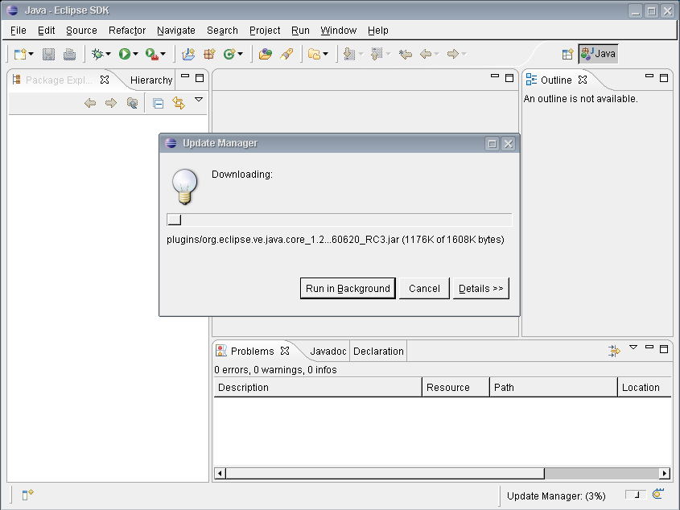
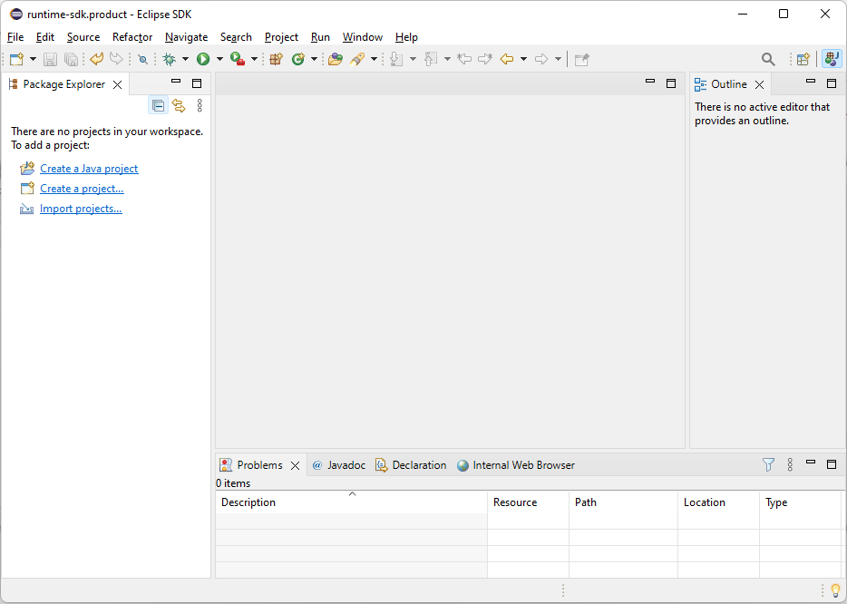
Recap: Eclipse Then and Now
2004
2024

Slide 3
Recap: Project Goal
Develop a 4th Eclipse/SWT implementation
… that is …
OS-agnostic
compatible with the existing API
… in order to …
enable improved look & feel
improve customizability
reduce maintenance effort
(by finally deprecating/replacing existing implementations)
Constrained by: low effort for adopters and available capacities/skillset

Slide 4
Recap: Project Phases
Prototypes
Prototypes
Techn. 1
Ski(j)a + Custom Widgets
Techn. 2
Techn. 3
Mature, Maintained
SWT Implementations
Techn. 2
Mature, Maintained
SWT Implementations
Mature, Maintained
SWT Implementations
Mature, Maintained
SWT Implementations
MacOS
MacOS
MacOS
MacOS
Windows
Windows
Windows
Windows
Mature, Maintained
SWT Implementations
Linux
Linux
Linux
Linux
Techn. 2
Starting Point
Prototype
Realization
Production
Replacement

Slide 5

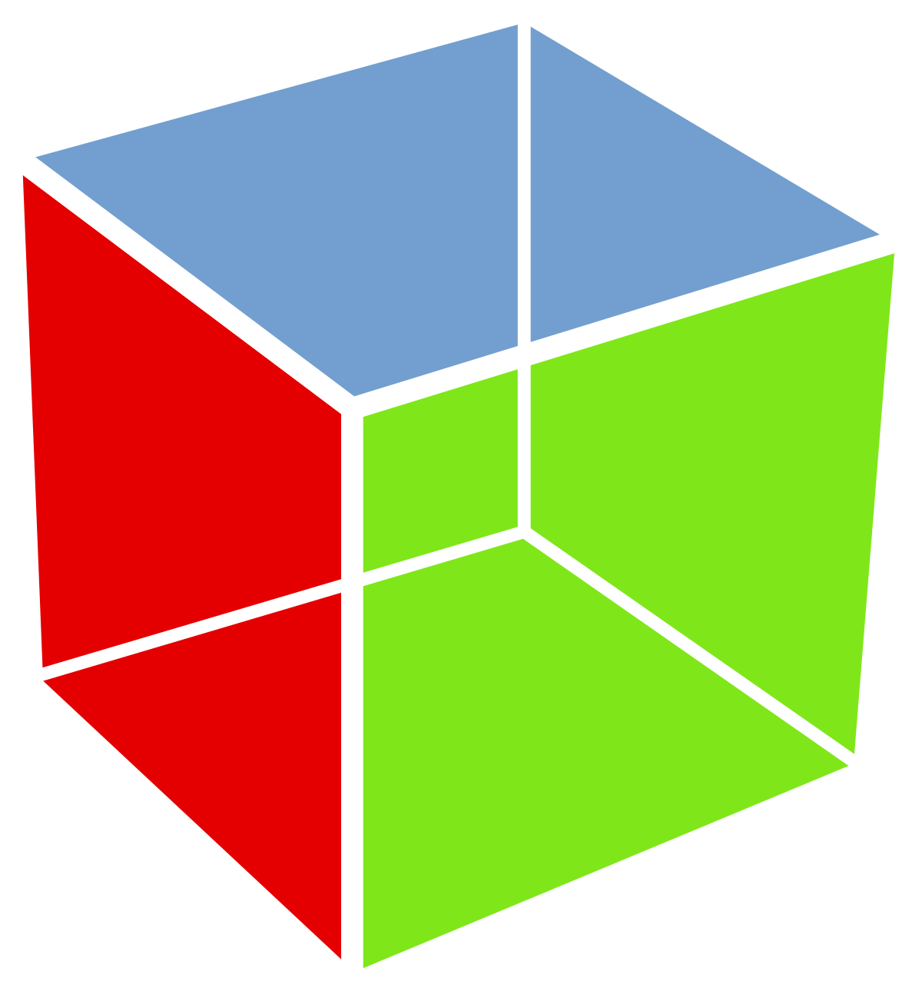

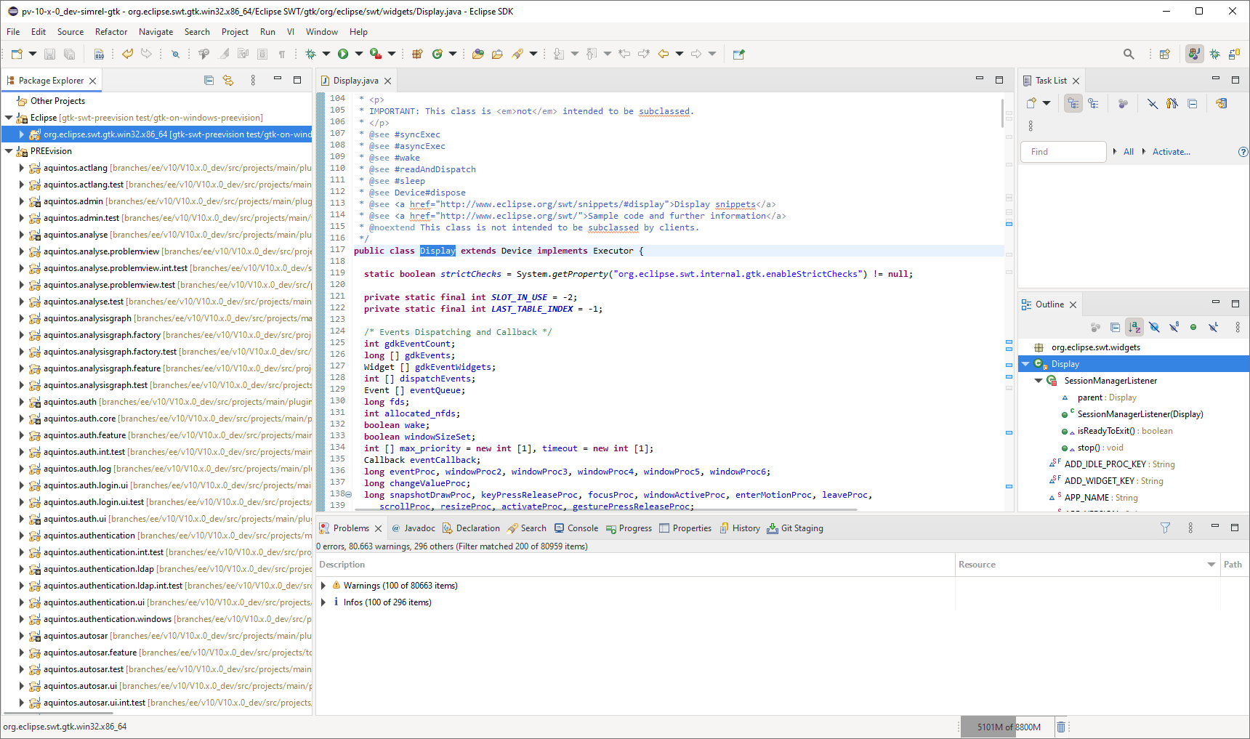
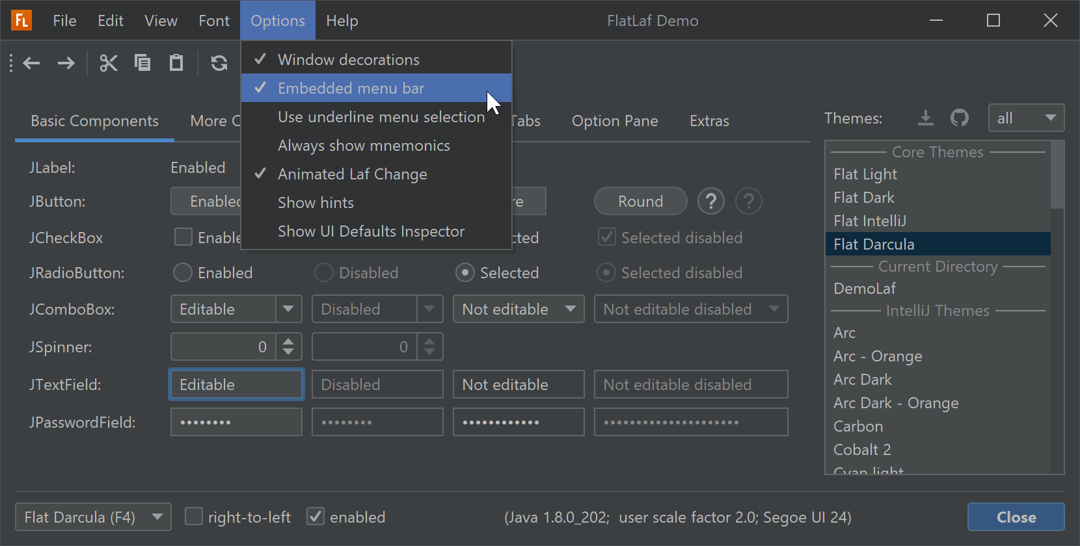
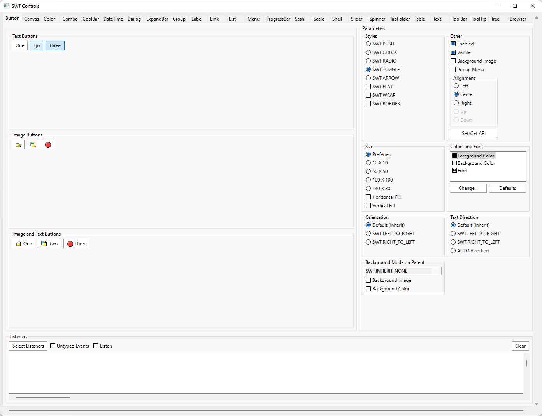
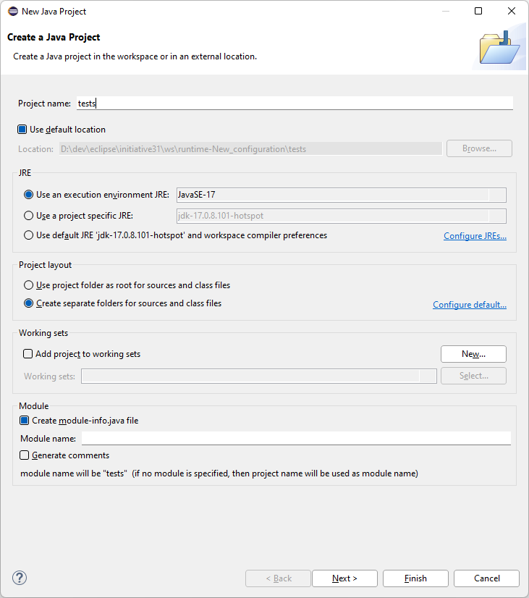
Current Technology Overview
GTK
with custom-drawn widgets
or LibreOffice/VCL widgets
No further investigation
No further investigation
  Implementation exists
  (for Linux)
  Windows/MacOS ports exist
  Native customizing via CSS
  GTK4 implementation required anyway
  Purely Java
  → skillset, deployment
  Platform independence
  (Java-supported ones)
  Partial implementation exists
  Theming, HiDPI, SVG support
  Modern, widely adopted rendering engine
  Platform independence
  (Skia-supported ones)
  Custom drawing:
    Purely Java → skillset
    Full control and flexibility

Slide 6
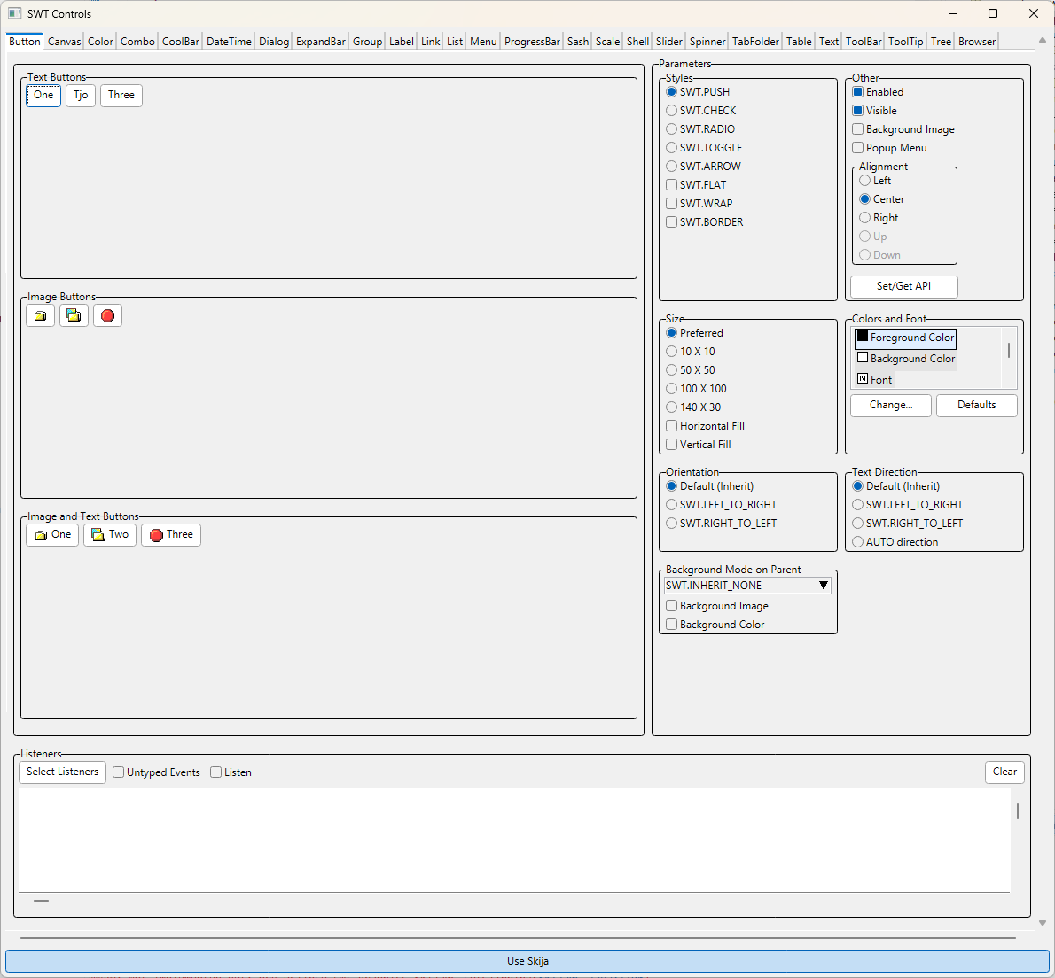
Custom-Drawn Widgets with Ski(j)a
February
Now

Slide 7
Target Technology Stack: Custom-Drawn
App
Eclipse Applications, JFace, …
Contains widget implementations against graphics library API
SWT
SWT API
OS-Agnostic SWT Graphics/Widgets
SWT Win Fragment
SWT Mac Fragment
SWT Linux Fragment
Lib
OS-Agnostic Graphics Framework/Library
Exchangeable graphics library, e.g., Skia
OS
Win32 (OLE/COM/…)
MacOS Cocoa (Foundation/…)
POSIX (Glib/DBUS/IO/…)

Slide 8
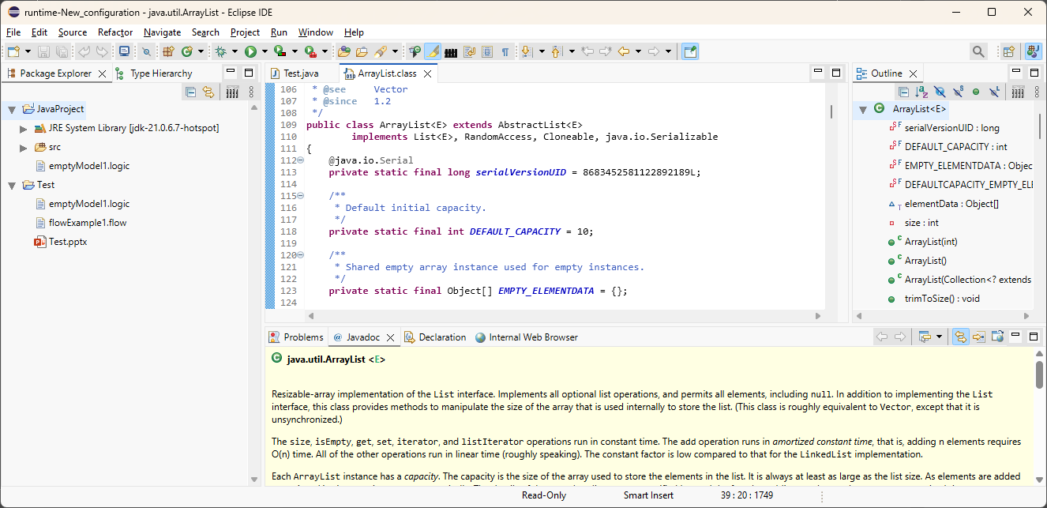
Current State + Live Demo

Slide 9
Achievements
Incremental Replacement: ControlExample / IDE still working
  Almost every widget rudimentary implemented
  In many cases, rendering possible with native GC and Skija GC
  Working on all three platforms
  CI: validation of compilation and selection of tests on all platforms
Experiments
  “One canvas” solution
  Skija with OpenGL (performance)

Slide 10
Partial / Incremental Custom Drawing
Window
(native)
Text
(native)
Button
(custom)
Custom widget can either directly draw onto native GC or onto other GC and copy result over
Shown to user
drawn
into
adapts
adapts
optionally uses
Win32
Skia
Window
Widgets
GC
GC
wraps and
copies to
render into
While some widgets (and the window) are still native, rendering into a custom GC (like Skia) requires a copy of the rendering result to an OS GC that renders into the native window.

Slide 11
Contributions
Most of them contributing part time
→ ~ 2-3 FTEs
Code Contributors
Current
Deepika Udayagiri (IBM)
Denis Ungemach (SAP)
Praveen S K (SAP)
Latha Patil (ETAS)
Raghundana M (Advantest)
Thomas Singer (Syntevo)
Former
Dieter Mai (SYSGO)
Federico Jeanne (Vector)
Heiko Klare (Vector)
Michael Schneider (SAP)
Additional Weekly Participants
Alex Kurtakov (Red Hat)
Alois Zoitl (University Linz)
Dominic Scharfe (COSEDA)
Harald Mackamul (Bosch)
Henrik Lochmann
Theo Dann-Muirhead (Renesas)
William Riley (Renesas)

Slide 12
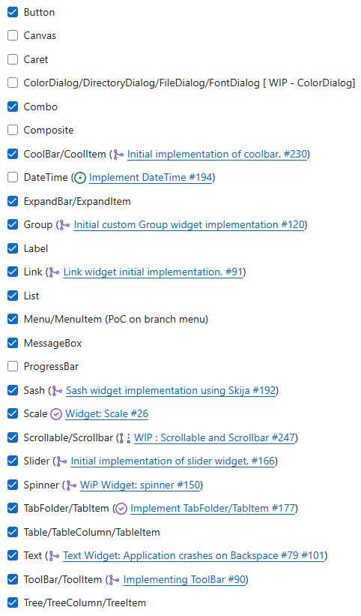
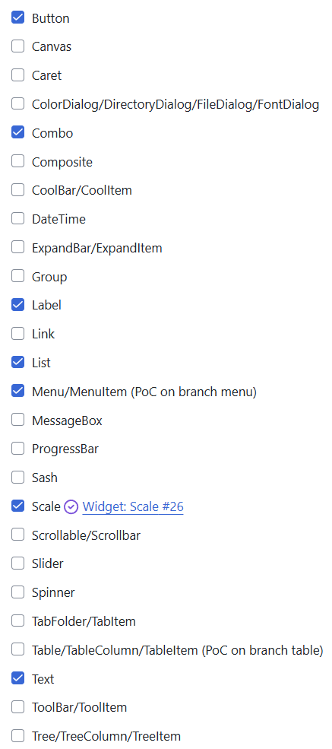
State Summary
Implemented widgets
(February 2025)
Implemented widgets
(June 2025)
Cross-cutting topics
(currently only prototyped)
Custom event handling
Efficiency of Skija rendering
Hardware acceleration
…
How long will it take?
Too long with the current number of contributors

Slide 13
Partial Upstream Contribution Options
Contribute Skija renderer for pure rendering tasks upstream
  Ski(j)a rendering could be used instead of native rendering
  For performance-critical, custom-drawn contents (e.g., GEF diagrams)
Incremental replacement of native with custom-drawn widgets
  Might reduce performance with native custom rendering (GC)
  Lock-in approach (or difficult to preserve native widgets next to their custom-drawn replacements)
  Messy integration of custom-drawn widgets with other native widgets

Slide 14
Thank you for the work done so far!

